Slide 1


genre filter FOR books section
Team ExtrAUDinary
Shreyansh Jain
Vineet Suhas Soni
Sanjana S
Adithya U
Vishal Shokeen

Slide 2
Agenda
01
02
03
04
05
Problem Statement
and Objectives
Solution
Challenges
Way forward
Recommendation

Slide 3
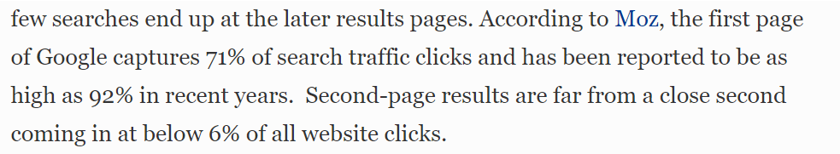
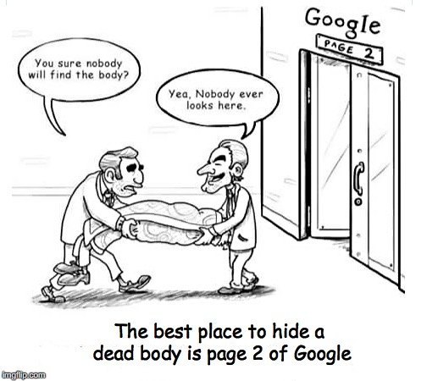

https://www.forbes.com/sites/forbesagencycouncil/2017/10/30/the-value-of-search-results-rankings/?sh=23a1470144d3

Slide 4


Introduction
Background
Problem Statement
Project Objectives
One of the largest peer-to-peer user classified website
Presence across more than 700 cities in 70 countries
Books section does not include Genre filter
Assign a genre to each book based on the information provided by the lister

Slide 5

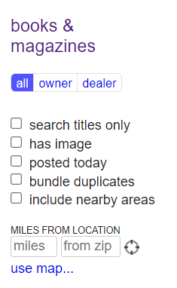
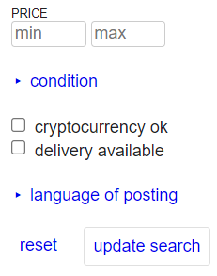
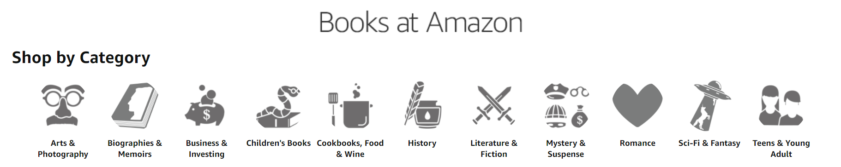
Issues
Lack of Genre-Specific filtering
The books section in craigslist has generic filters regarding metrics like location, price and condition. There is no information regarding Genre of the book.
Other marketplaces for books like Amazon and eBay have these filters built into their websites
This leads to increase in the time spent by the user to find the book and can affect their experience

Slide 6
01
02
03
04
05
Problem Statement
and Objectives
Solution
Challenges
Way forward
Recommendation

Slide 7
Potential solutions to the issues
Classification Model
Text analytics to identify genre of the books. Classification model to categorize them into their respective genres.
Train model to classify into 14 different genres like History, Travel, Fiction etc.
Seattle listings
(971)
Amazon listings
(207,000)

Slide 8





Analysis: Detailed flowchart
Manual genre tagging of books
Train, Validate and Test various models
Scrape Craigslist’s Book listing
Tokenize, Stop- words removal and Tf-IDF vectorization
Model is finalized based on validation set accuracy

Slide 9








Model Accuracy comparison
Train
Validation
Craigslist
Naïve Bayes
79.5%
70.8%
57%
Logistic Regression
73.7%
69.1%
59%
Decision Tree
71.2%
56%
41.2%
Random Forest
63.9%
54.7%
39.2%
Neural Networks
79.6%
71.9%
60%
SVM
75.4%
70.4%
62.8%

Slide 10
01
02
03
04
05
Problem Statement
and Objectives
Solution
Challenges
Way forward
Recommendation

Slide 11
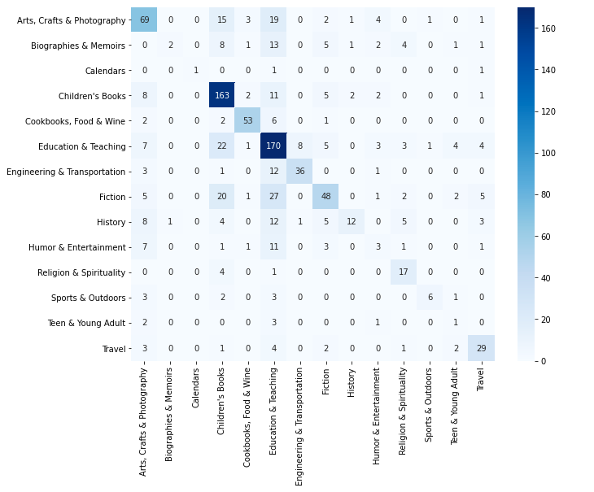

Model Confusion matrix
Majority of misclassification were in Fiction and History books section
Actual
Predictions

Slide 12
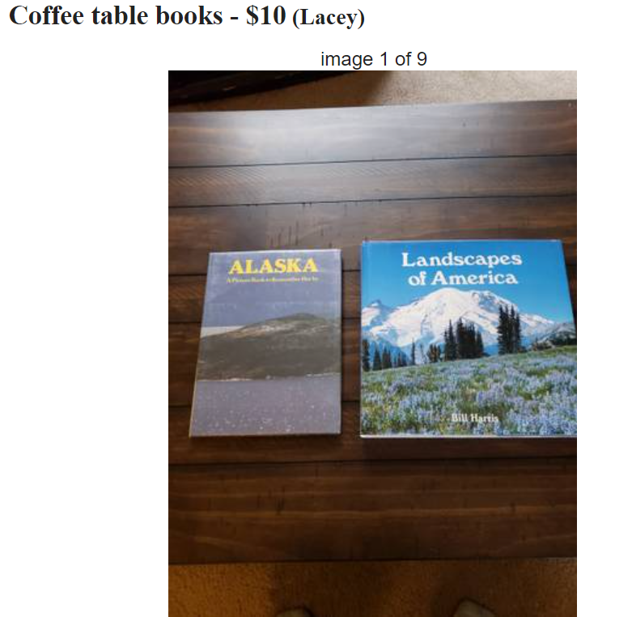
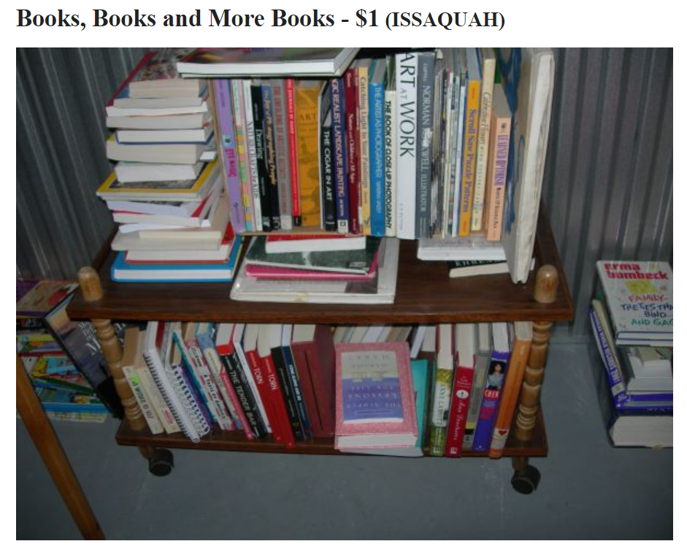

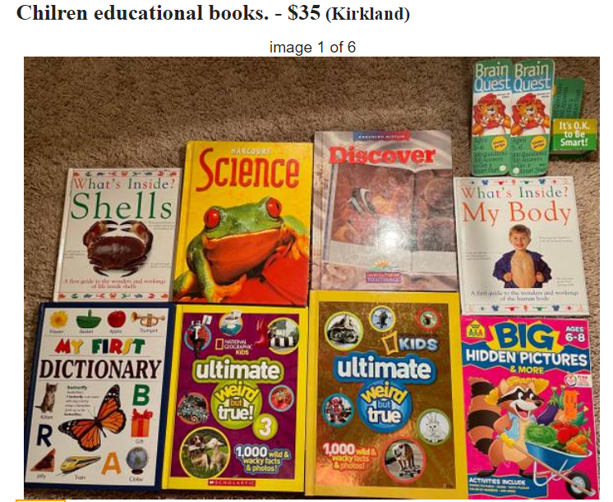
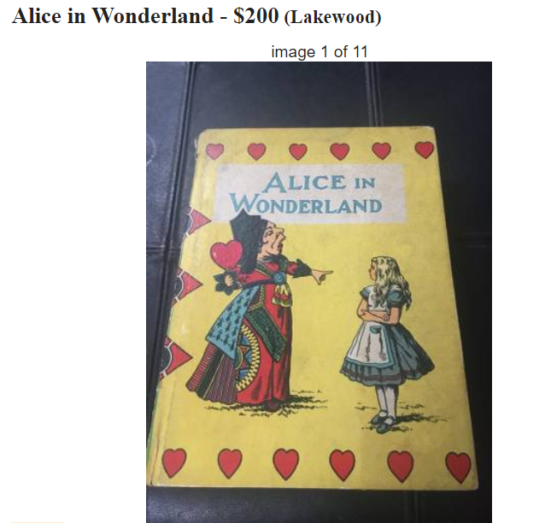
Challenges and Solutions
Ambiguous titles (15%)
Multiple books (5%)
OCR
Soft-tagging
Misspelled titles (2%)
Multiple Genres (5%)

Slide 13
01
02
03
04
05
Problem Statement
and Objectives
Recommendation
Solution
Way forward
Recommendation

Slide 14



Additional Image Analysis
Preprocess the image to make it clearer
Tokenize and process text
Scrape Craigslist’s Book listing along with the image
Use Tesseract to convert image to text.
Validate it with title

Slide 15
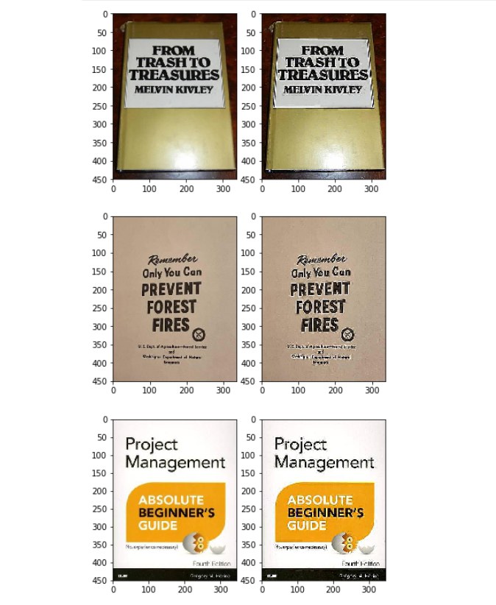

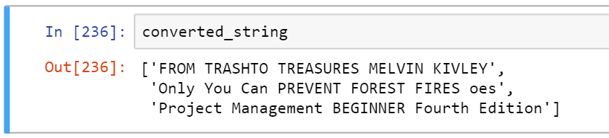
Result
Original
Processed

Slide 16
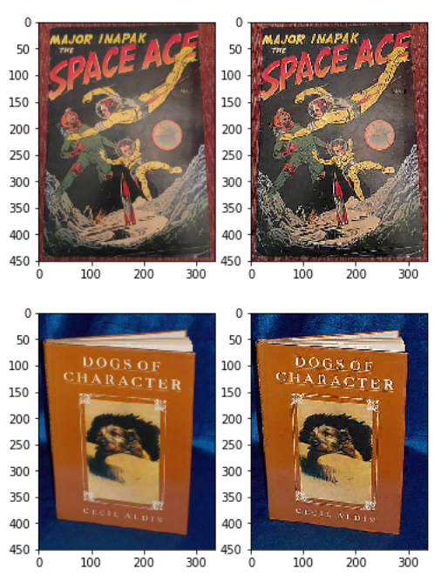
Result
Original
Processed
Image-to-Text
'OS ppg hese MAJOR INAPAK PE Mh THE jaye ZA el AGE ea eds Lan hi gg Ny Ra ae SES Seen Sn fe yA sige San NCAA Saar', 'DOGS OF CHARACTER E Poe oe eo SE CUES'

Slide 17
01
02
03
04
05
Problem Statement
and Objectives
Recommendation
Solution
Way forward
Recommendation

Slide 18




Final Recommendation
Book genre classification for enhanced user experience.
Screen image and suggest title resulting in simplification of ad posting and enhanced data quality.
The same concept can be implemented to other sections like arts & crafts, electronics etc.
Outcome
Improved buyers and advertisers experience
Keeping Craigslist Simplicity Intact

Slide 19

Questions?

Slide 20
Appendix

Slide 21
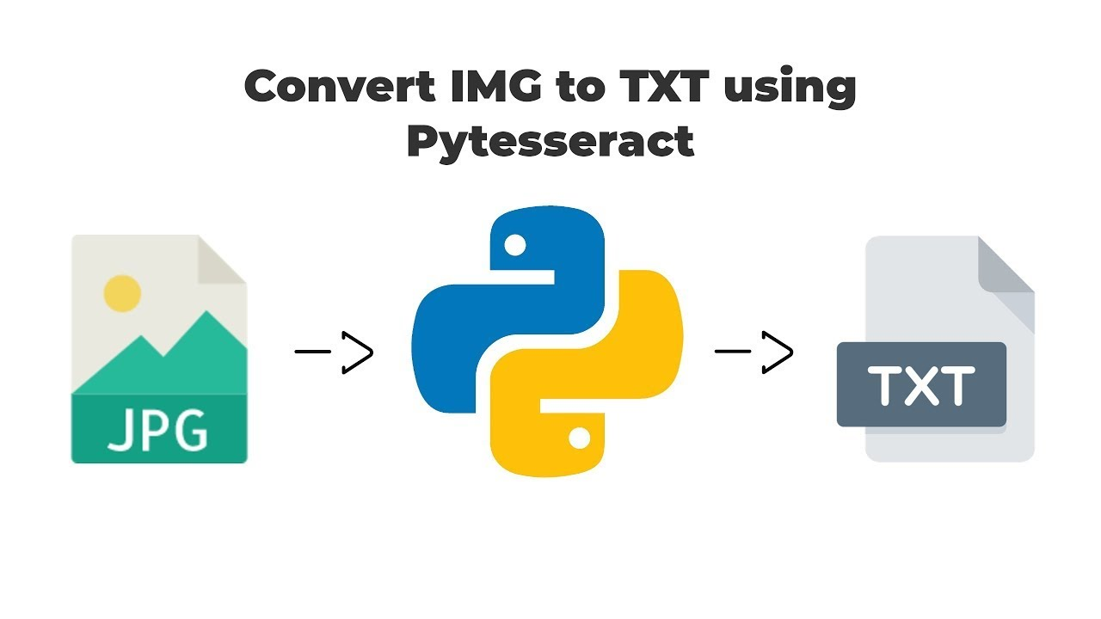

PyTesseract
Py-Tesseract is a wrapper for Google's Tesseract-OCR Engine.
It is a standalone invocation script to tesseract, as it can read all image types supported by the Pillow and Leptonica imaging libraries.

Slide 22
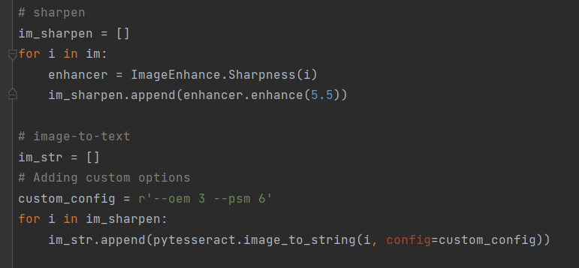


Tesseract - Code
Image Pre-Processing
Image-to-Text

Slide 23
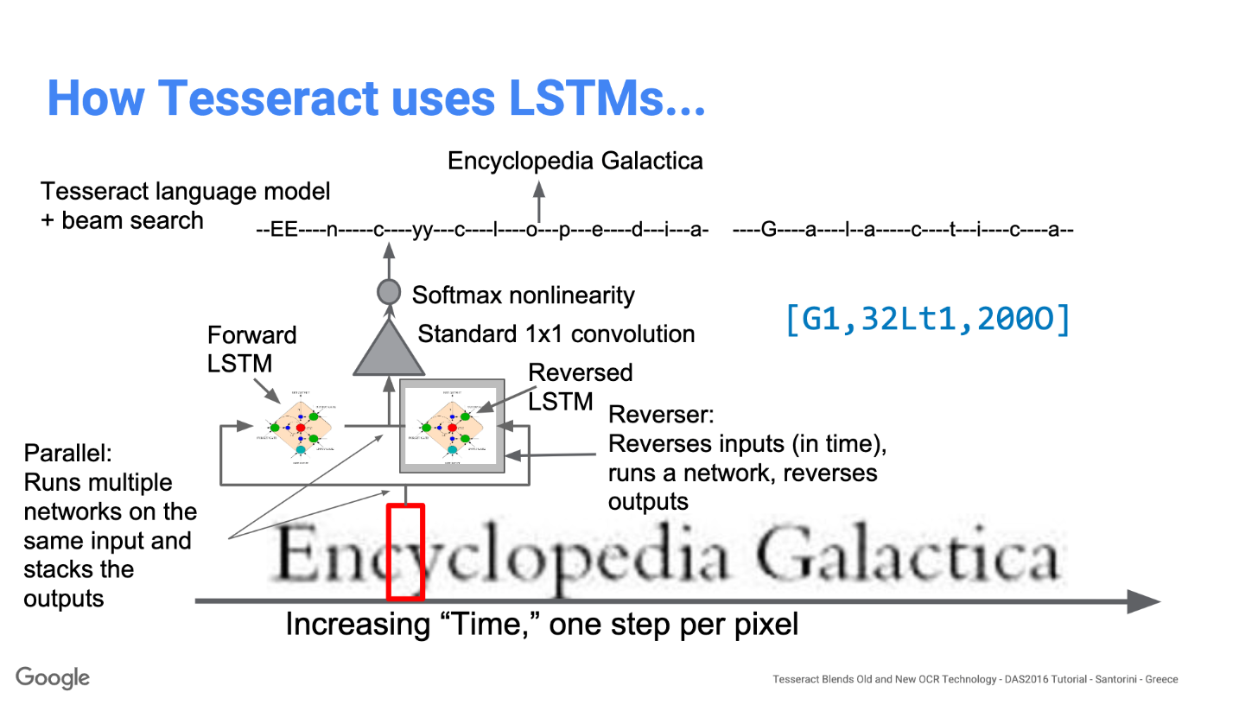
Tesseract - Working

